Slide 1
Revenue Forecasting Using an Adaptive Hybrid Time Series Framework
Accurate 30-day revenue forecasting for business planning and strategic decision-making through an innovative adaptive hybrid approach.

Slide 2



Project Objectives
30-Day Forecast
Predict daily revenue for the next 30 days using historical data.
Model Comparison
Build and compare baseline, ARIMA, ML regression, and hybrid models.
Performance Metrics
Evaluate using RMSE and MAE error metrics.
Interactive Interface
Visualize results with Streamlit dashboard.

Slide 3

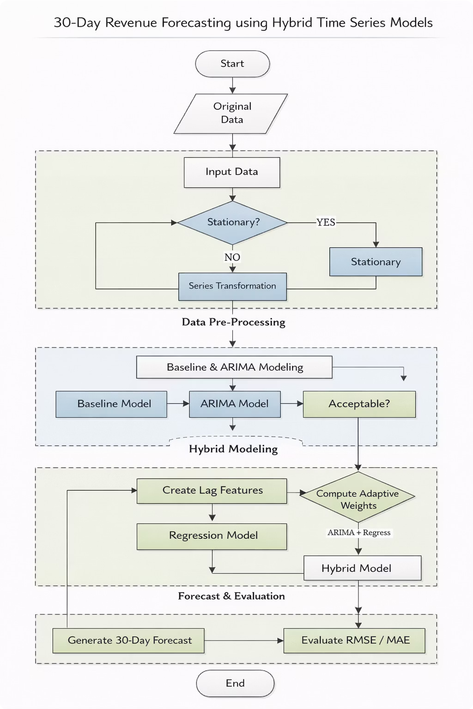
Dataset Overview
Data Structure
Historical daily revenue records with customer ID, date, and revenue value columns.
Preprocessing Steps
Convert dates to datetime format Sort chronologically
Check for missing values
Resample to daily frequency Fill missing values
Identify trends and outliers

Slide 4

Baseline Forecasting Model
Naive Forecast
Assumes the next value equals the last observed value. Simple but effective baseline.
Moving Average
Predicts future values as the average of the last k days. Smooths out noise.
These baseline models serve as reference points to measure improvement from advanced techniques.

Slide 5

ARIMA: Statistical Time Series Model
What is ARIMA?
AutoRegressive Integrated Moving Average models linear patterns like trend and seasonality in time series data.
Implementation Steps
Check stationarity and apply differencing
Select parameters (p, d, q)
Train on training data
Generate predictions
Store for evaluation

Slide 6



Machine Learning Regression Model
Transforms forecasting into supervised learning using engineered features to capture nonlinear relationships.
Lag Features
Previous day, one week ago, two weeks ago revenue values.
Rolling Statistics
7-day and 14-day means and standard deviations for trend and volatility.
Trend Features
Slope calculations to capture direction and strength of trends.
Calendar Features
Day of week and weekend indicators for seasonality patterns.

Slide 7



Trend Regime Detection
Revenue behavior changes over time. This analysis identifies different trend periods to support adaptive forecasting.
Uptrend
Positive slope indicates growth period
Stable
Near-zero slope shows steady state
Downtrend
Negative slope signals decline

Slide 8

Adaptive Hybrid Forecasting
Dynamic weighting strategy combines ARIMA and ML predictions for improved robustness.
01
Evaluate Models
Test both models on recent validation window
02
Calculate Errors
Compute RMSE or MAE for each model
03
Assign Weights
Weight inversely proportional to errors
04
Combine Predictions
Fuse models using calculated weights

Slide 9
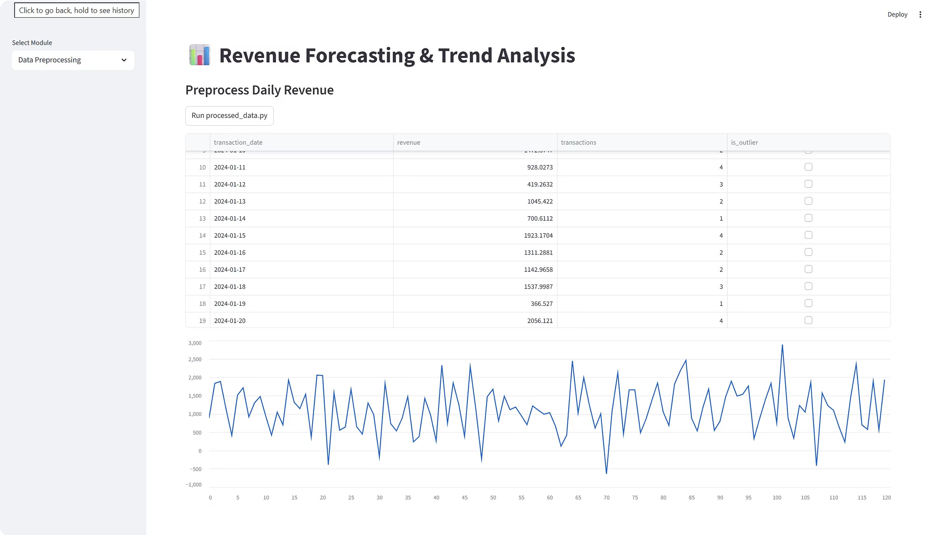
Visualization and User Interface
Streamlit Dashboard Features
Historical revenue trend displays Actual vs predicted comparisons 30-day future forecast visualization Model evaluation metrics
Interactive interface makes results accessible to both technical and non- technical users.

Slide 10
THANK YOU
RAJESH M
C KAILASH ESWAR
MANASA MAGANTI

